Slide 1
THE BATTLE OF NEIGHBORHOODS
Submitted by-
Chitrangadh raghuwanshi

Slide 2
INTRODUCTION-
The problem this project aims to solve is to analyse the location of coffee shops in New York city, which will help the tourists to find the best place around which they may reside to find most of these coffee shops near them.

Slide 3
DATA SECTION-
In this project, we leverage foursquare location data to render the location of coffee shops in New York city.
To do this, the url for calling the foursquare API contains the category id of coffee shops, as shown below:
'https://api.foursquare.com/v2/venues/explore?&client_id={}&client_secret={}&v={}&near={}&limit={}&categoryId={}‘.format(CLIENT_ID, CLIENT_SECRET, VERSION, city, LIMIT,"4bf58dd8d48988d1e0931735")
"4bf58dd8d48988d1e0931735“ is the foursquare category id for coffee shops, as seen above.

Slide 4
METHODOLOGY-
First we obtain the location data for coffee shops in New York city. This is done by calling the foursquare API using the explore endpoint and using the CategoryID to set it to show only coffee shops.
Then we map these coffee shops using the Folium library. In the map we see the city is dense with coffee shops.
Now, to get a concrete measure of this density, we obtain the mean coordinate of all these coffee shop markers on the map, and take the average of the distance of venues to the mean coordinate.

Slide 5
RESULTS-
A map showing coffee shops represented by blue markers is generated using folium library.
Another map is generated which shows the mean coordinate of all the coffee shops represented by a green marker, and the distance of each coffee shop with the mean coordinate is represented by green line.
The average distance of all coffee shops to mean coordinate comes out to be 0.025294035751581546.

Slide 6
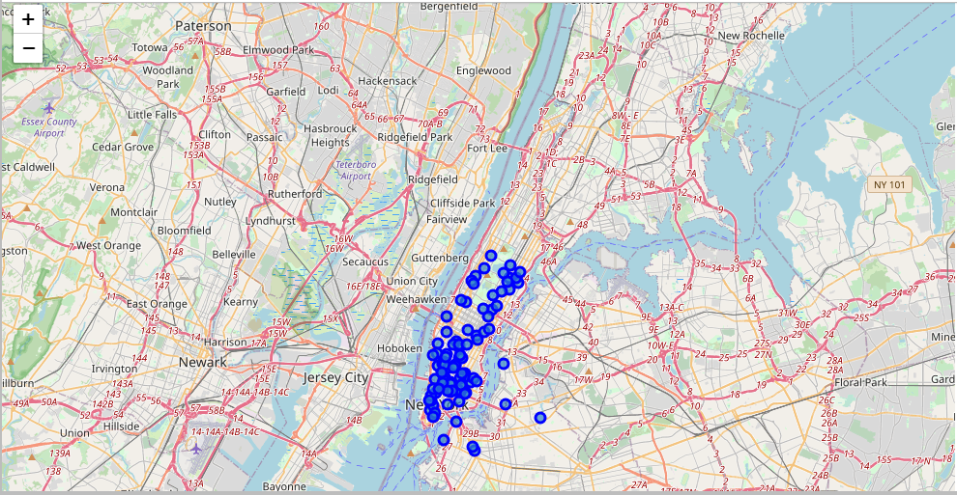
Map showing coffee shops as blue markers.

Slide 7
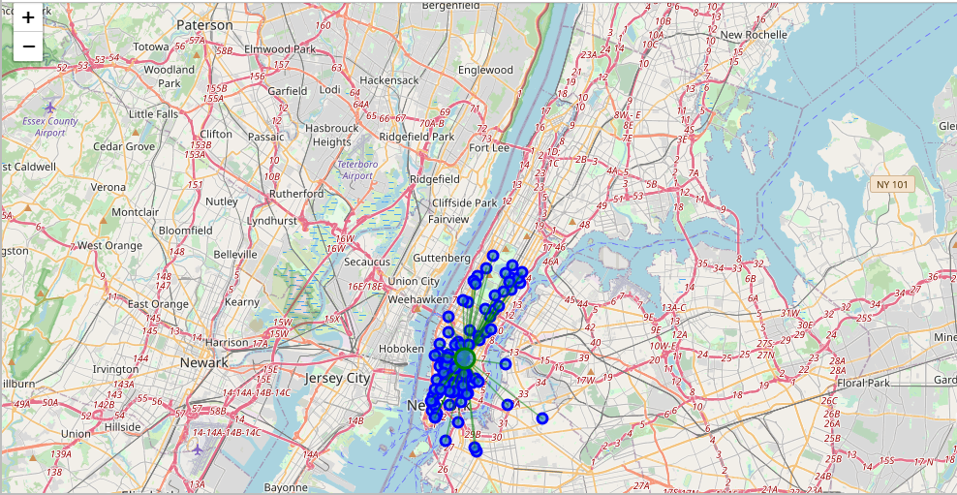
This map shows the mean coordinate represented by a green marker, and the distance of each coffee shop with the mean coordinate is represented by green line.

Slide 8
DISCUSSION-
The mean location can be taken as a point which will be near to most of the venues. Thus it would be best for the tourists to book their hotel near that mean coordinate to surround themselves with most of these coffee shops.

Slide 9
CONCLUSION-
I conclude this presentation by saying that in order to surround them with most of the coffee shops analysed in the notebook, i recommend the interested tourists to book their hotel close to the mean coordinate.

Slide 10
THANK YOU

